Slide 1
Software Quality Assurance
Dr. Seemab Latif
Lecture No. 9
29th November, 2010

Slide 2
Unit Testing
First level of testing.
Refers to testing program units in isolation.
A program unit implements a function, it is natural to test the unit before it is integrated with other units.

Slide 3
What is a Unit?
Syntactically, a program unit is a piece of code, such as a function or method of class, that is invoked from outside the unit and that can invoke other program units.
Moreover, a program unit is assumed to implement a well-defined function providing a certain level of abstraction to the implementation of higher level functions.
Why units need to be tested?
The function performed by a program unit may not have a direct association with a system-level function. Thus, a program unit may be viewed as a piece of code implementing a “low”-level function
Given that a program unit implements a function, it is only natural to test the unit before it is integrated with other units.

Slide 4
Unit Testing in Stand-alone manner
There are two reasons for testing a unit in a stand-alone manner.
First, errors found during testing can be attributed to a specific unit so that it can be easily fixed.
Second, during unit testing it is desirable to verify that each distinct execution of a program unit produces the expected result.

Slide 5
Scope of Unit Testing
Unit testing has a limited scope. A programmer will need to verify whether or not a code works correctly by performing unit-level testing. Intuitively, a programmer needs to test a unit as follows:
Execute every line of code. This is desirable because the programmer needs to know what happens when a line of code is executed. In the absence of such basic observations, surprises at a later stage can be expensive.
Execute every predicate in the unit to evaluate them to true and false separately.
Observe that the unit performs its intended function and ensure that it contains no known errors.

Slide 6
Brain Storming!!!
In spite of the tests discussed on previous slide, there is no guarantee that a satisfactorily tested unit is functionally correct from a system wide perspective.
WHY???
Not everything relevant to a unit can be tested in isolation because of the limitations of testing in isolation. This means that some errors in a program unit can only be found later, when the unit is integrated with other units in the integration testing and system testing phases.

Slide 7
Brain Storming!!!
It serves no purpose to integrate an erroneous unit with other units for the following reasons:
WHAT CAN BE THE REASONS??
Many of the subsequent tests will be a waste of resources and
Finding the root causes of failures in an integrated system is more resource consuming.

Slide 8
Who Performs the Unit Testing?
Unit testing is performed by the programmer who writes the program unit because the programmer is intimately familiar with the internal details of the unit.
The objective for the programmer is to be satisfied that the unit works as expected.

Slide 9
Phases of Unit Testing
Static Unit Testing
Dynamic Unit Testing

Slide 10
Static Unit Testing
A programmer does not execute the unit; instead, the code is examined over all possible behaviours that might arise during run time.
Also known as non-execution-based unit testing.
Code is reviewed by applying techniques commonly known as inspection and walkthrough.
Inspection: is a step-by-step peer group review of a work product, with each step checked against predetermined criteria.
Walkthrough: is a review where the author leads the team through a manual or simulated execution of the product using predefined scenarios.

Slide 11
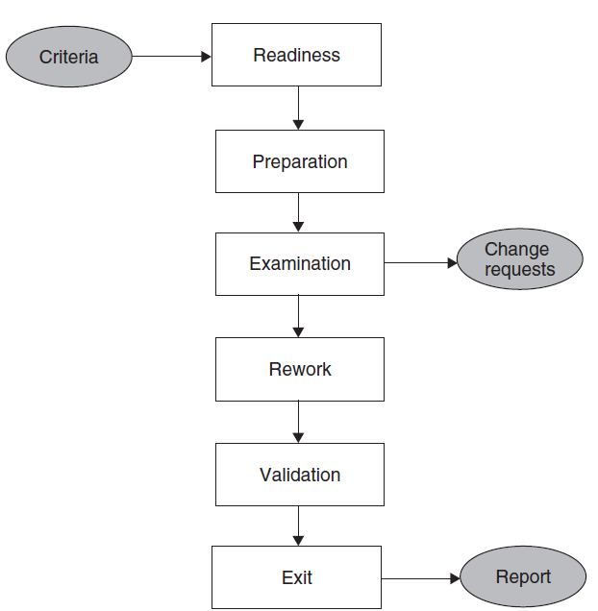
Inspection--Code Review
A code review can be done as a special kind of inspection in which the team examines a sample of code and fixes any defects in it.
The general guidelines for performing code review consists of six steps as outlined in the Figure: readiness, preparation, examination, rework, validation, and exit.

Slide 12
Code Review Process
Step 1: Readiness: The author of the unit ensures that the unit under test is ready for review. A unit is said to be ready if it satisfies the following criteria:
Completeness: code relating to the unit to be reviewed must be available,
Minimal Functionality: code must compile and link.
Readability: highly readable code.
Complexity:The code to be reviewed must be of sufficient complexity (no. of conditional statements, input/output data elements, real-time processing of the code, and the no. of other units with which the code communicates).
Requirements and Design Documents: latest approved version of the low-level design specification must be available.

Slide 13
Code Review Process
Step 2: Preparation: Before the meeting, each inspector carefully reviews the work package. It is expected that the inspectors read the code and understand its organization and operation before the review meeting. Each inspector develops the following:
List of Questions: An inspector prepares a list of questions to be asked, if needed, of the author to clarify issues arising from his or her reading.
Potential Change Request: An inspector may make a formal request to make a change.
Suggested Improvement Opportunities: The inspectors may suggest how to fix the problems, if there are any, in the code under review.

Slide 14
Code Review Checklist
Does the code do what has been specified in the design specification?
Does the procedure used in the module solve the problem correctly?
Does a software module duplicate another existing module which could be reused?
If library modules are being used, are the right libraries and the right versions of the libraries being used?
Does each module have a single entry point and a single exit point? Multiple exit and entry point programs are harder to test.
Is the cyclomatic complexity of the module more than 10? If yes, then it is extremely difficult to adequately test the module.
Can each atomic function be reviewed and understood in 10–15 minutes? If not, it is considered to be too complex.
Have naming conventions been followed for all identifiers, such as pointers, indices, variables, arrays, and constants? It is important to adhere to coding standards to ease the introduction of a new contributor (programmer) to the development of a system.
Has the code been adequately commented upon?
Have all the variables and constants been correctly initialized? Have correct types and scopes been checked?
Are the global or shared variables, if there are any, carefully controlled?
Are there data values hard coded in the program? Rather, these should be declared as variables.
Are the pointers being used correctly?
Are the dynamically acquired memory blocks de-allocated after use?
Does the module terminate abnormally? Will the module eventually terminate?
Is there a possibility of an infinite loop, a loop that never executes, or a loop with a premature exit?
Have all the files been opened for use and closed at termination?
Are there computations using variables with inconsistent data types? Is overflow or underflow a possibility?
Are error codes and condition messages produced by accessing a common table of messages? Each error code should have a meaning, and all of the meanings should be available at one place in a table rather than scattered all over the program code.
Is the code portable? The source code is likely to execute on multiple processor architectures and on different operating systems over its lifetime. It must be implemented in a manner that does not preclude this kind of a variety of execution environments.
Is the code efficient? In general, clarity, readability, or correctness should not be sacrificed for efficiency. Code review is intended to detect implementation choices that have adverse effects on system performance.

Slide 15
Code Review Process
Step 3: Examination :The examination process consists of the following activities:
The author makes a presentation of the procedural logic used in the code, the paths denoting major computations, and the dependency of the unit under review on other units.
The reader reads the code line by line. The inspector may raise questions if the code is seen to have defects.
The recorder documents the change requests and the suggestions for fixing the problems, if there are any.
A Change Request (CR) includes the following details:
Give a brief description of the issue or action item.
Assign a priority level (major or minor) to a CR.
Assign a person to follow up the issue.
Set a deadline for addressing a CR.

Slide 16
Code Review Process
Step 4: Rework: At the end of the meeting, the recorder produces a summary of the meeting that includes the following information:
A list of all the CRs, the dates by which those will be fixed, and the names of the persons responsible for validating the CRs
A list of improvement opportunities
The minutes of the meeting (optional)
A copy of the report is distributed to all the members of the review group. After the meeting, the author works on the CRs to fix the problems.
The author documents the improvements made to the code in the CRs. The author makes an attempt to address the issues within the agreed-upon time frame using the prevailing coding conventions.

Slide 17
Code Review Process
Step 5: Validation: The CRs are independently validated by the moderator or another person designated for this purpose.
The validation process involves checking the modified code as documented in the CRs and ensuring that the suggested improvements have been implemented correctly.
The revised and final version of the outcome of the review meeting is distributed to all the group members.

Slide 18
Dynamic Unit Testing
Dynamic unit testing is execution based and the outcomes of the execution are observed.
Also known as Execution-based unit testing.
Note: Static unit testing is not an alternative of dynamic unit testing, a programmer performs both kinds of tests.

Slide 19
Dynamic Unit Testing
In this testing, a program unit is actually executed in isolation. However, this execution differs from ordinary execution in the following way:
A unit under test is taken out of its actual execution environment.
The actual execution environment is emulated by writing more code so that the unit and the emulated environment can be compiled together.
The above compiled aggregate is executed with selected inputs. The outcome of such an execution is collected in a variety of ways, such as straightforward observation on a screen, logging on files, and software instrumentation of the code to reveal run time behaviour. The result is compared with the expected outcome. Any difference between the actual and expected outcome implies a failure and the fault is in the code.

Slide 20
Example:
Imagine you are writing the tests for a bank's Automatic Teller Machine. Withdraw functionality of the ATM is called by the user by pressing ‘Withdraw’ button on the screen: atm.pressButton("Withdraw");
Actual Code:
private Status doWithdrawal(Account account, float amount) {
Transaction transaction = new Transaction();
transaction.setSourceAccount(account);
transaction.setDestAccount(myCashAccount());
transaction.setAmount(amount);
transaction.process();
if (transaction.successful()) {
dispense(amount); }
return transaction.getStatus(); }

Slide 21
Test Case Code:
public void testCheckingWithdrawal() {
float startingBalance = balanceForTestCheckingAccount();
AtmGui atm = new AtmGui();
insertCardAndInputPin(atm);
atm.pressButton("Withdraw");
atm.pressButton("Checking");
atm.pressButtons("1", "0", "0", "0", "0"); assertContains("$100.00",
atm.getDisplayContents());
atm.pressButton("Continue");
assertEquals(startingBalance - 100, balanceForTestCheckingAccount());
}
Emulated Code:
private MockTransaction extends Transaction {
private boolean processCalled = false;
// override process method so that no real work is done public void process() {
processCalled = true;
setStatus(Status.SUCCESS);
}
.
.
}

Slide 22
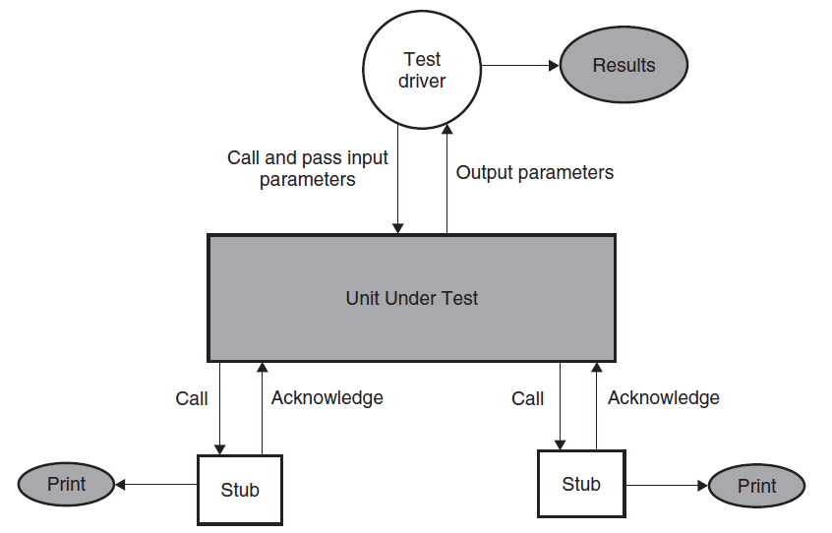
Environment for Dynamic Unit Testing
An environment for dynamic unit testing is created by emulating the context of the unit under test
The caller unit is known as a test driver, and all the emulations of the units called by the unit under test are called stubs

Slide 23
Test Driver and Stubs
Test Driver: A test driver is a program that invokes the unit under test. The unit under test executes with input values received from the driver and, upon termination, returns a value to the driver. The driver compares the actual outcome, that is, the actual value returned by the unit under test with the expected outcome from the unit and reports the ensuing test result. The test driver functions as the main unit in the execution process. The driver not only facilitates compilation, but also provides input data to the unit under test in the expected format.
Stubs: A stub is a “dummy subprogram” that replaces a unit that is called by the unit under test. A stub performs two tasks. First, it shows an evidence that the stub was, in fact, called. Such evidence can be shown by merely printing a message. Second, the stub returns a pre-computed value to the caller so that the unit under test can continue its execution.

Slide 24
Unit Testing Tasks and Steps
Step 1: Create a Test Plan
Step 2: Create Test Cases and Test Data
Step 3: If applicable create scripts to run test cases
Step 4: Once the code is ready execute the test cases
Step 5: Fix the bugs if any and re test the code
Step 6: Repeat the test cycle until the “unit” is free of all bug

Slide 25
What is a Unit Test Plan?
This document describes the Test Plan in other words how the tests will be carried out.
This will typically include the list of things to be Tested, Roles and Responsibilities, prerequisites to begin Testing, Test Environment, Assumptions, what to do after a test is successfully carried out, what to do if test fails, Glossary and so on

Slide 26
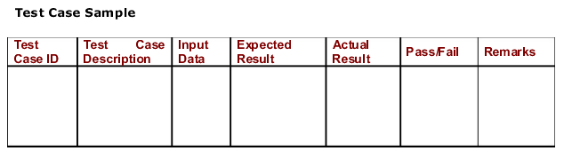
What is captured in a Test Case?
Additionally the following information may also be captured: a) Unit Name and Version Being tested b) Tested By c) Date d) Test Iteration (One or more iterations of unit testing may
be performed)

Slide 27
Steps to Effective Unit Testing
Documentation: document all the Test Cases needed to test your code. A lot of times this task is not given due importance. Document the Test Cases, actual Results when executing the Test Cases, Response Time of the code for each test case. There are several important advantages if the test cases and the actual execution of test cases are well documented.
Documenting Test Cases prevents oversight.
Documentation clearly indicates the quality of test cases
If the code needs to be retested we can be sure that we did not miss anything
It provides a level of transparency of what was really tested during unit testing. This is one of the most important aspects.
It helps in knowledge transfer in case of employee attrition
Sometimes Unit Test Cases can be used to develop test cases for other levels of testing

Slide 28
Steps to Effective Unit Testing
What should be tested when Unit Testing: A lot depends on the type of program or unit that is being created. It could be a screen or a component or a web service. Broadly the following aspects should be considered:
For a UI screen include test cases to verify all the screen elements that need to appear on the screen
For a UI screen include Test cases to verify the spelling/font/size of all the “labels” or text that appears on the screen
Create Test Cases such that every line of code in the unit is tested at least once in a test cycle
Create Test Cases such that every condition in case of “conditional statements” is tested once
Create Test Cases to test the minimum/maximum range of data that can be entered. For example what is the maximum “amount” that can be entered or the max length of string that can be entered or passed in as a parameter
Create Test Cases to verify how various errors are handled
Create Test Cases to verify if all the validations are being performed

Slide 29
Steps to Effective Unit Testing
Automate where Necessary: Time pressures/Pressure to get the job done may result in developers cutting corners in unit testing. Sometimes it helps to write scripts, which automate a part of unit testing. This may help ensure that the necessary tests were done and may result in saving time required to perform the tests.

Slide 30
Summary
“Unit Testing” is the first level of testing and the most important one.
Detecting and fixing bugs early on in the Software Lifecycle helps reduce costly fixes later on.
An Effective Unit Testing Process can and should be developed to increase the Software Reliability and credibility of the developer.
This lecture explains how Unit Testing should be done and the important points that should be considered when doing Unit Testing.
Many new developers take the unit testing tasks lightly and realize the importance of Unit Testing further down the road if they are still part of the project.

